Slide 1
Chapter 2 Defining the Role of Data
Seeing data as a universal resource
Obtaining and manipulating data
Looking for mistruths in data
Defining data-acquisitions limits
Considering data security

Slide 2
Every interesting application ever written for a computer has data associated with it.
The use of advanced hardware and improvements in algorithms make data the universal resource for AI today.
Today, applications collect data manually, as done in the past, and also automatically, using new methods.
Collecting this data ethically.
Raw data doesn’t usually work well for analysis purposes. Manipulating and shaping the data are required.

Slide 3
Finding Data Ubiquitous in This Age
Big data is more than a just a buzz phrase used by vendors to propose new ways to store data and analyze it.
The big data revolution is an everyday reality and a driving force of our times.
Big data refers to large and complex amounts of computer data, so large and intricate that applications can’t deal with the data simply by using additional storage or increasing computer power.
Big data implies a revolution in data storage and manipulation.

Slide 4
You can view data as being one of two types, structured and unstructured, depending on how you produce and consume it.
Typical examples of structured data are database tables, in which information is arranged into columns, and each column contains a specific type of information.
Unstructured data consists of images, videos, and sound recordings. You may use an unstructured form for text so that you can tag it with characteristics, such as size, date, or content type.
Transforming unstructured data into a structured form can cost lots of time and effort and can involve the work of many people.

Slide 5
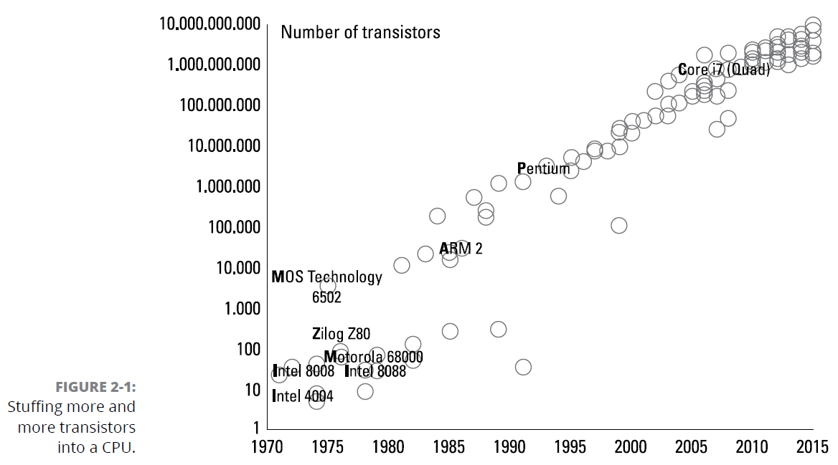
Understanding Moore’s implications

Slide 6
Since 1965, the doubling of components every two years has ushered in great advancements in digital electronics that has had far-reaching consequences in the acquisition, storage, manipulation, and management of data.
Many engineers are now saying that Moore’s Law is dead.
Charles Leiserson and Neil Thompson are of a different mindset, saying that improvements will come from better software, algorithms, and specialized chip architecture.
In the future, Moore’s Law may not apply because industry will switch to a new technology, such as optical computing and quantum computers.

Slide 7
Moore’s Law has a direct effect on data.
The greater the diffusion, the lower the price becomes, creating an endless loop that drives the use of powerful computing machines and small sensors everywhere.
With large amounts of computer memory available and larger storage disks for data, the consequences are an expansion of data availability, such as websites, transaction records, measurements, digital images, and other sorts of data.

Slide 8
Using data everywhere
Big data isn’t a fad created by software and hardware vendors but has a basis in many scientific fields, such as astronomy (space missions), satellite (surveillance and monitoring), meteorology, physics (particle accelerators) and genomics (DNA sequences).
AI application can specialize in a scientific field.
Actual AI applications are mostly prized for being able to recognize objects, move along paths, or understand what people say and speak to them.
Data contribution to the actual AI renaissance that molded it in such a fashion didn’t derive from the classical sources of scientific data.

Slide 9
The Internet now generates and distributes new data in large amounts.
Large repositories of faces and expressions from photos and videos posted on social media websites.
Privately held medical information and biometric data from smart watches.
Datasets of how people relate to each other and what drives their interest from sources such as social media and search engines
Information on how we speak is recorded by mobile phones.
The Internet of Things (IoT) is becoming a reality.
Many other common tools of everyday life are becoming interconnected (from the refrigerator to the toothbrush) and able to process, record, and transmit data.

Slide 10
Putting algorithms into action
The human race is now at an incredible intersection of unprecedented volumes of data, generated by increasingly smaller and powerful hardware.
Some people call such data the “new oil.” These new values mostly exist in how applications manicure, store, and retrieve data, and in how you actually use it by means of smart algorithms.
Algorithms and AI changed the data game.
Simple algorithms
Symbolic reasoning based on logic
Expert systems

Slide 11
In recent years, AI algorithms have moved to neural networks and, in their most mature form, deep learning.
Data turned from being just the raw material that fueled the solution to the artisan of the solution itself.

Slide 12
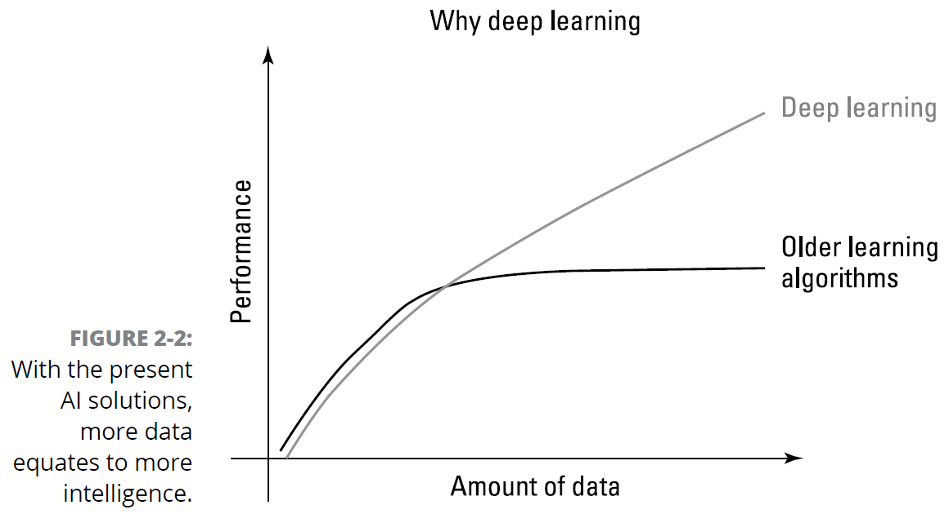

Slide 13
On a larger scale, a company like Google feeds its algorithms from freely available data, such as the content of websites or the text found in publicly available texts and books.
Google spider software crawls the web, jumping from website to website, retrieving web pages with their content of text and images.
Even if Google gives back part of the data to users as search results, it extracts other kinds of information from the data using its AI algorithms, which learn from it how to achieve other objectives.

Slide 14
Algorithms that process words can help Google AI systems understand and anticipate your needs even when you are not expressing them in a set of keywords but in plain, unclear natural language, the language we speak every day (and yes, everyday language is often unclear).
Google has steadily become better able to understand synonyms and concepts, something that goes beyond the initial data that it acquired, and this is the result of an AI process.

Slide 15
Using Data Successfully
The following sections help you understand how to collect, manipulate, and automate data collection from an overview perspective.

Slide 16
Considering the data sources
Many data sources today rely on input gathered from human sources
Data is also collected from sensors, and these sensors can take almost any form.

Slide 17
Obtaining reliable data
The word reliable seems so easy to define, yet so hard to implement.
We want reliable, mundane, fully anticipated data that simply confirms what we already know, but the unexpected is what makes collecting the data useful in the first place.
Ensuring data reliability means that after the data arrives, no one tampers with it to make it fit within an expected domain (making it mundane as a result).

Slide 18
Making human input more reliable
Humans make mistakes — it’s part of being human. In fact, expecting that humans won’t make mistakes is unreasonable.

Slide 19
Using automated data collection
Automated data collection does provide a number of benefits:
Better consistency
Improved reliability
Lower probability of missing data
Enhanced accuracy
Reduced variance for things like timed inputs
Automated data collection still relies on sensors, applications, and computer hardware designed by humans that provide access only to the data that humans decide to allow.

Slide 20
Collecting personal data ethically
For some people, anything that appears on the Internet is automatically considered public domain — including people’s faces and all their personal information.
The fact is that you should consider everything as being copyrighted and not available for use in a public domain manner to use data safely.
Even people who realize that material is copyrighted will often fall back on fair-use principles.

Slide 21
No matter where you stand on the free-use issue, you still need to consider the ethical use of data that you obtain no matter what the source might be.
Obtaining permission: Some research will require you to be able to identify persons used within a dataset.
Using sanitization techniques: Data sanitization involves removing personal information.
Avoiding Data Inference: When collecting data, some users will refuse to share personally identifiable information
Avoiding generalizations: It’s essential to remember that statistics apply to groups, not to individuals.

Slide 22
Manicuring the Data
No matter what term you use, however, raw data seldom meets the requirements for processing and analysis. To get something out of the data, you must manicure it to meet specific needs. The following sections discuss data manicuring needs.

Slide 23
Dealing with missing data
To answer a given question correctly, you must have all the facts.
Identifying that your dataset is missing information can actually be quite hard because it requires you to look at the data at a low level — something that most people aren’t prepared to do and is time consuming even if you do have the required skills.

Slide 24
Calculate the missing data from other data that you can access.
Locate the missing data in another dataset.
Combine datasets to create a whole that provides consistent fields.
Collect additional data from various sources to fill in the missing data.
Redefine your question so that you no longer need the missing data.

Slide 25
Separating useful data from other data
To solve problems efficiently, an AI requires just enough data. Defining the question that you want to answer concisely and clearly helps, as does using the correct algorithm (or algorithm ensemble).
The major problems with having too much data are that finding the solution (after wading through all that extra data) takes longer, and sometimes you get confusing results because you can’t see the forest for the trees.

Slide 26
Considering the Five Mistruths in Data
Commission
Omission
Perspective
Bias
Frame of reference

Slide 27
Defining the Limits of Data Acquisition
Addresses a need — and then ascertain what sorts of information you need to answer the question.
Automation would produce reliable, repeatable, and consistent data input.
Many factors in automating data acquisition can produce data that isn’t particularly useful.

Slide 28
Sensors can collect only the data that they’re designed to collect, so you might miss data when the sensors used aren’t designed for the purpose.
People create errant data in various ways (see the “Considering the Five Mistruths in Data” section, earlier in this chapter, for details), which means that data you receive might be false.
Data can become skewed when the conditions for collecting it are incorrectly defined.
Interpreting data incorrectly means that the results will also be incorrect.
Converting a real-world question into an algorithm that the computer can understand is an error-prone process.

Slide 29
Considering Data Security Issues
This section discusses data security from the perspective of protecting data integrity, rather than keeping someone from stealing it or guarding privacy.

Slide 30
Understanding purposefully biased data
The dataset is often biased because the collection methods are biased, the analysis methods are biased, and the data itself is biased.
The people using the dataset purposely bias it in some manner.
Political: Political maneuvering can become the source of data bias.
Medical: When medical groups advertise for people to participate in trials of medications, procedures, and other needs, the group they get often doesn’t represent the population as a whole, so the data is biased.
Legal: The use of COMPAS to predict the potential for recidivism is another example of data and algorithm bias
Other: Any time a dataset and its associated algorithms become influenced by bias, the outcome is less than ideal.

Slide 31
Dealing with data-source corruption
Data sources can become corrupt.
Data-source corruption comes from many other sources:
A sensor might be bad, producing erroneous results.
A virus attack might cause data errors.
The database or other software contains a flaw.
Humans enter the data incorrectly into the database.
Acts of nature, such as lightning, cause momentary glitches in data collection.

Slide 32
Cancelling botnets with sinkholing
Botnets are coordinated groups of computers that focus on performing specific tasks, most of them nefarious.
Botnets generally corrupt or bias data in ways that cause any kind of analysis to fail.
One of the best methods for dealing with these botnets is to sinkhole them — that is, redirect them to a location where they can’t do any harm.

